Slide 1
Data science class II: Intro to machine learning
Notes:
~15-20 min on initial stuff
Note: example DS problem…write down some features, how could you build a predictive model from these?

Slide 2
agenda
PURPOSE OF MACHINE LEARNING & PREDICTIVE MODELING
LOSS FUNCTION
SUPERVISED VS UNSUPERVISED ALGORITHMS
CATEGORIAL VS CONTINIOUS FEATURE SPACES
INTERPRETATION OF PREDICTIVE MODELING RESULTS
Notes:
All of our classes will involve some hands-on work (in the exercises section)

Slide 3
MACHINE LEARNIng
INTRO TO DATA SCIENCE
Notes:
Introductions
discuss student backgrounds
discuss reasons for interest in data science

Slide 4
INTROS
GOAL OF MACHINE LEARNING
Notes:
~15-20 min for this section?

Slide 5
SUPERVISED ALGORITHMS
Algorithms which take as input, data and their corresponding class, or value
Rectangle
Hexagon
Oval
Trapezoid
Cirle
Notes:
~15-20 min for this section?

Slide 6
SUPERVISED ALGORITHMS
Goal is to predict future values correctly
??
Notes:
~15-20 min for this section?

Slide 7
SUPERVISED ALGORITHMS
Take data (such as behavior of users signing up for a website building product) as well as actual result
DOW #Direct #Organic #Paid #Adding a title # Purchases
Wed 1,583 2,738 938 1,532 873
Thur 5,382 1,728 532 2,321 1,232
.
.
.
Mon 4,132 7,212 432 987 2,123
Notes:
~15-20 min for this section?

Slide 8
SUPERVISED ALGORITHMS
And can predict the value for unseen data
DOW #Direct #Organic #Paid #Adding a title Predicted Purchase
Tue 3,132 7,212 432 512 1,773
Notes:
~15-20 min for this section?

Slide 9
UNSUPERVISED ALGORITHMS
Algorithms which take as input only the data about the object, but not its class
Notes:
~15-20 min for this section?

Slide 10
UNSUPERVISED ALGORITHMS
Goal might be to infer patterns about the data that weren’t obvious to the user
Notes:
~15-20 min for this section?

Slide 11
Loss Function
The way all these algorithms work is by minimizing its own LOSS FUNCTION.
Loss function – A function that quantifies the error rate of an algorithm.
Notes:
~15-20 min for this section?

Slide 12
Loss Function
Example: Let’s say that you’re trying to draw a line through some points. What loss function would you use?
Notes:
~15-20 min for this section?

Slide 13
Loss Function
Many different kinds of loss functions
Notes:
~15-20 min for this section?

Slide 14
Supervised learning
INTRO TO DATA SCIENCE
Notes:
Introductions
discuss student backgrounds
discuss reasons for interest in data science

Slide 15
unsupervised learning
INTRO TO DATA SCIENCE
Notes:
Introductions
discuss student backgrounds
discuss reasons for interest in data science

Slide 16
Types of Machine Learning:
Supervised Learning
There are two main categories of machine learning: supervised learning and unsupervised learning.
Supervised learning (aka “predictive modeling”):
Predict an outcome based on input data
Example: predict whether an email is spam or ham
Goal is “generalization”

Slide 17
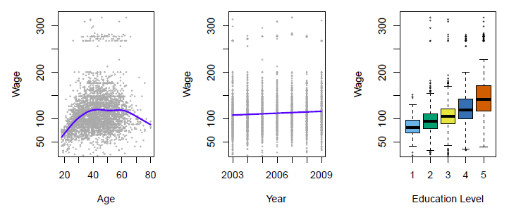
Supervised Learning Example
Predict salary using demographic data
Income survey data for males from the central Atlantic region of the USA in 2009
Source: https://class.stanford.edu/c4x/HumanitiesScience/StatLearning/asset/introduction.pdf

Slide 18
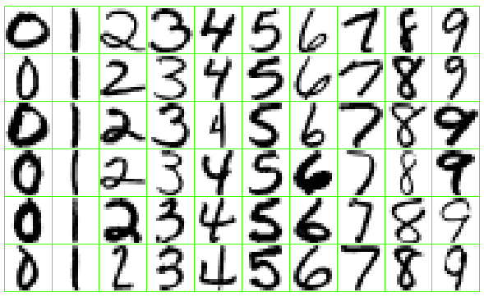
Supervised Learning Example
Identify the numbers in a handwritten zip code
Source: https://class.stanford.edu/c4x/HumanitiesScience/StatLearning/asset/introduction.pdf

Slide 19
Categories of Supervised Learning
There are two categories of supervised learning:
Regression
Outcome we are trying to predict is continuous
Examples: price, blood pressure
Classification
Outcome we are trying to predict is categorical (values in a finite, unordered set)
Examples: spam/ham, cancer class of tissue sample

Slide 20
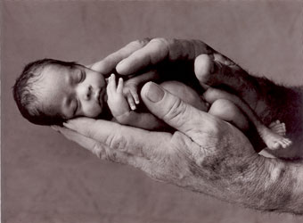
Regression or Classification?
Problem: Children born prematurely are at high risk of developing infections, many of which are not detected until after the baby is sick
Goal: Detect subtle patterns in the data that predicts infection before it occurs
Data: 16 vital signs such as heart rate, respiration rate, blood pressure, etc…
Impact: Model is able to predict the onset of infection 24 hours before the traditional symptoms of infection appear
Image: http://www.babycaretips4u.com/wp-content/uploads/2014/03/premature-baby.jpg
Case Study: http://www.amazon.com/Big-Data-Revolution-Transform-Think/dp/0544002695

Slide 21
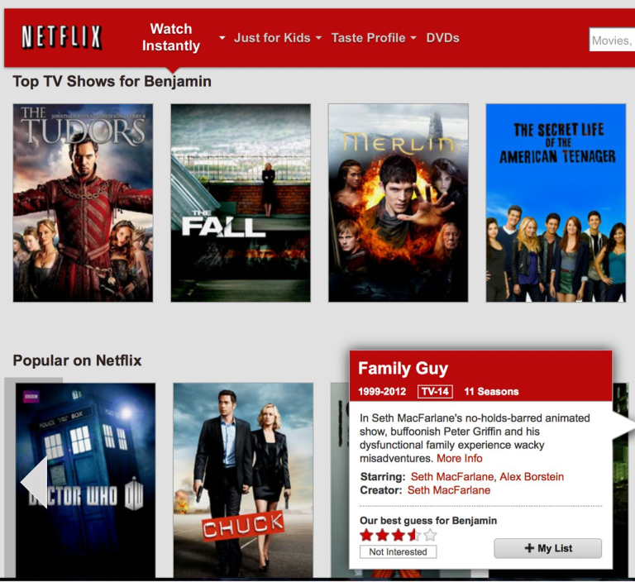
Regression or Classification?

Slide 22
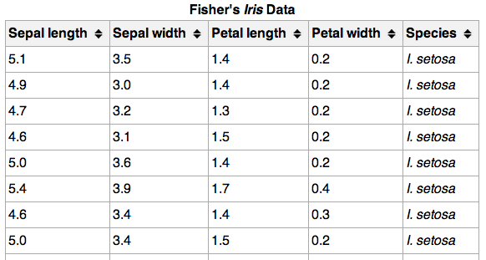
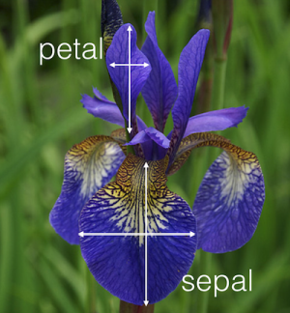
Regression or Classification?

Slide 23
Machine Learning Terminology
}
150 observations
(n = 150)
{
Feature matrix “X” has n rows and p columns
Response “y” is a vector with length n
{
response
4 features (p = 4)

Slide 24
Machine Learning Terminology
Observations are also known as: samples, examples, instances, records
Features are also known as: predictors, independent variables, inputs, regressors, covariates, attributes
Response is also known as: outcome, label, target, dependent variable
Regression problems have a continuous response. Classification problems have a categorical response. The type of supervised learning problem has nothing to do with the features!

Slide 25
Supervised Learning
How does supervised learning “work”?
Train a machine learning model using labeled data
“Labeled data” is data with a response variable
“Machine learning model” learns the relationship between the features and the response
Make predictions on new data for which the response is unknown
The primary goal of supervised learning is to build a model that “generalizes”: It accurately predicts the future rather than the past!

Slide 26
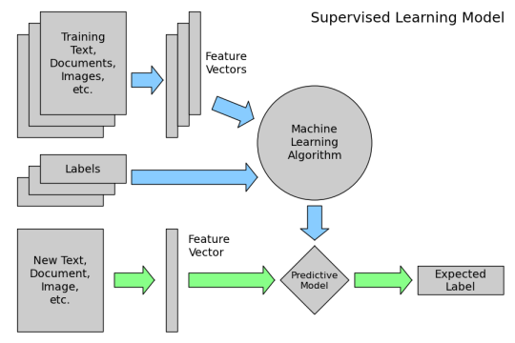
Supervised Learning
How does supervised learning “work”?

Slide 27
Supervised Learning Example
Supervised learning example: Dog detector
Input data: Images from Google
Features: Numerical representations of the images
Response: Dog (yes or no), hand-labeled
Train a machine learning model using labeled data
Model learns the relationship between the image data and the “dog status”
Make predictions on new data for which the response is unknown
Give it a new image, predicts the “dog status” automatically

Slide 28
unsupervised learning
INTRO TO DATA SCIENCE
Notes:
Introductions
discuss student backgrounds
discuss reasons for interest in data science

Slide 29
Types of Machine Learning: Unsupervised Learning
There are two main categories of machine learning: supervised learning and unsupervised learning.
Unsupervised learning:
Extracting structure from data
Example: segment grocery store shoppers into “clusters” that exhibit similar behaviors
Goal is “representation”

Slide 30
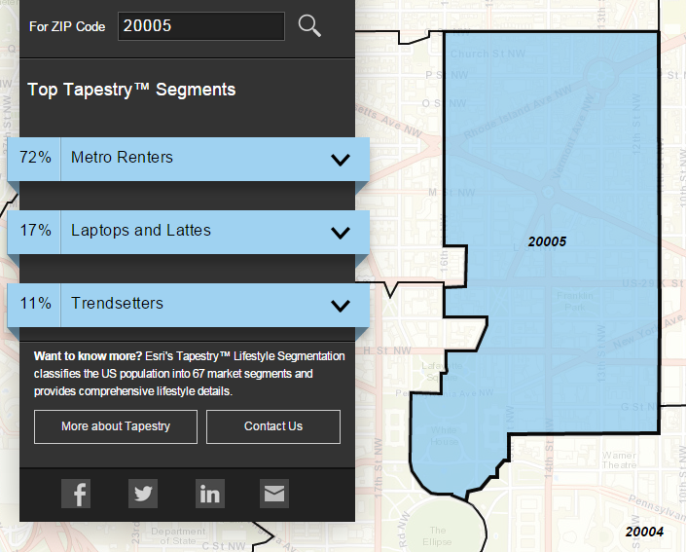
Unsupervised Learning Example
Classify US residential neighborhoods into 67 unique segments based on demographic and socioeconomic characteristics
Metro Renters:
Young, mobile, educated, or still in school, we live alone or with a roommate in rented apartments or condos in the center of the city. Long hours and hard work don’t deter us; we’re willing to take risks to get to the top of our professions… We buy groceries at Whole Foods and Trader Joe’s and shop for clothes at Banana Republic, Nordstrom, and Gap. We practice yoga, go skiing, and attend Pilates sessions.
Source: http://www.esri.com/landing-pages/tapestry/

Slide 31
Unsupervised Learning
Unsupervised learning has some clear differences from supervised learning. With unsupervised learning:
There is no clear objective
There is no “right anwser” (hard to tell how well you are doing)
There is no response variable, just observations with features
Labeled data is not required

Slide 32
Unsupervised Learning Example
Unsupervised learning example: Image clustering
Input data: Images from Google
Features: Numerical representations of the images
Response: There isn’t one (no hand-labeling required!)
Perform unsupervised learning
Cluster the images based on “similarity”
Might find a “dog cluster”, might not
You’re done!
Sometimes, unsupervised learning is used as a “preprocessing” step for supervised learning.

Slide 33
Dealing with types of variables
INTRO TO DATA SCIENCE
Notes:
~15-20 min for this section?

Slide 34
continuous variables
CONTINUOUS VARIABLES – Variables that can be described on an “ordinal” scale – i.e. the difference between 5 and 6 is the same as the difference between 6 and 7

Slide 35
continuous variables
Common operations on continuous variables:
Center Variables (subtract the mean)
Scale Variables (divide by the standard deviation)

Slide 36
continuous variables
Centering variables:
Reason #1 for center variables
Reason #2 for centering variables

Slide 37
continuous variables
Scaling Variables
Reason #1 for center variables
Reason #2 for centering variables

Slide 38
Categorical variables
Categorial Variables – These are variables that are described by groups, or segments. Here the difference between 2 and 3 is not the same as between 3 and 4.

Slide 39
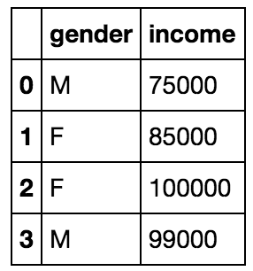
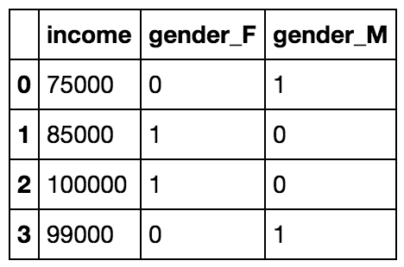
Categorical variables
Converting Categorical to Numerical
*To properly use this data we actually need to drop one of the categorical columns, more on that later

Slide 40
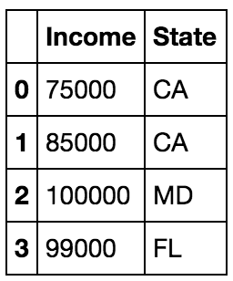
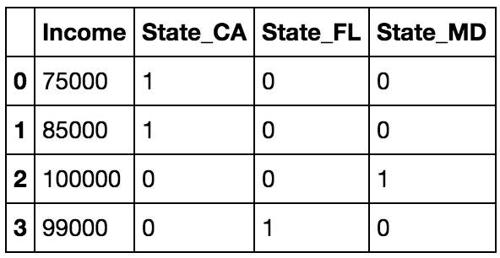
Categorical variables
Converting Categorical to Numerical
*To properly use this data we actually need to drop one of the categorical columns, more on that later

Slide 41
Python & pandas
INTRO TO DATA SCIENCE
Notes:
Introductions
discuss student backgrounds
discuss reasons for interest in data science

Slide 42
Categorical variables
Let’s work through some basic pandas work. Please load up the notebook.

